Slide 1
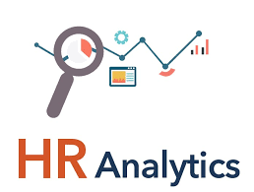
hr Analytics presentation

Slide 2
Team Member Group 2
Sahil Ganji
Suresh Prajapath
Mohini Wanjari
Rahul Sid
Vijay Kumar
Yash Ghosalkar
Raman

Slide 3
Introduction
The datasets HR_1 and HR_2 serve as the foundation for our project of HR Analytics within the project "Employee Retention“.
We had calculated the fields from the Year, Month, Day of joining field ( First Create a Date Field as Date of Joining) then Year, Month no, Month full name, Quarter(Q1,Q2,Q3,Q4), Year Month ( YYYY-MMM), Weekday no, Weekday name, Financial Month and Financial Quarter
Calculated the KPI such as Attrition rate, Total employees, Active employees, Attrition Count, Average of work-life balance, monthly income and Average hourly rate.
We had created some KPIs using visualization tools to provide insights about Average Attrition rate for all Departments, Average Hourly rate of Male Research Scientist, Attrition rate Vs Monthly income stats, Average working years for each Department, Department wise No. of Employees, Count of Employees based on Educational Fields, Job Role Vs Work life balance, Attrition rate Vs Year since last promotion relation, Gender based Percentage of Employee, Monthly New Hire vs Attrition Trendline, Department / Job Role wise job satisfaction.

Slide 4
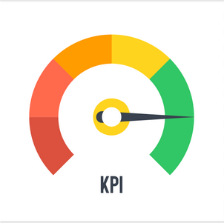
KPI’s
1)Average Attrition rate for all Departments
4)Job Role Vs Work life balance
2)Average working years for each Department
5)Gender based Percentage of Employee
3)Departmentwise No of Employees
6)Deptarment / Job Role wise job satisfaction

Slide 5
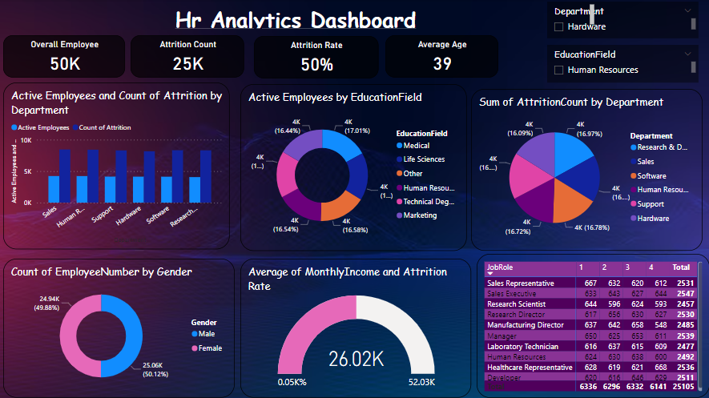

Slide 6
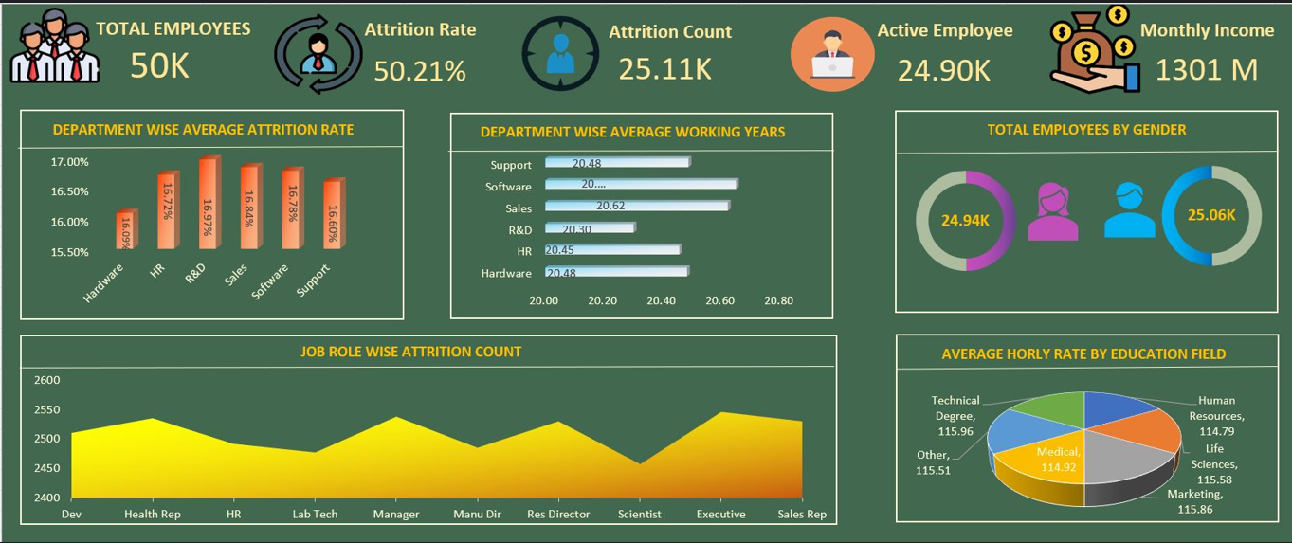

Slide 8
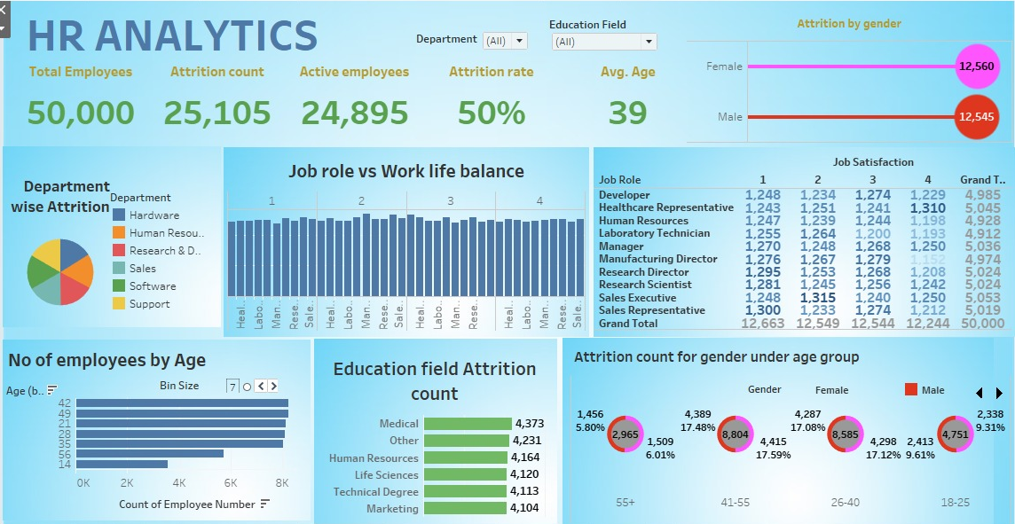

Slide 9
OVERVIEW OF A DASHBOARD
Excel dashboard capturing the pulse of employee retention in our organization, a total workforce of 50,000 comes into focus. Currently, 24,900 employees actively contribute to our company, showcasing a balanced gender distribution with 24,940 females and 25,060 males. We've used Power BI’s visualization tools to show important information. Pictures like Clustered Column Charts ,Donut charts, pie chart . We had presented as Average Attrition rate for all Departments, Average Hourly rate of Male Research Scientist, Attrition rate Vs Monthly income stats, Average working years for each Department, Department wise No of Employees and Count of Employees based on Educational Fields. Line chart is used to show Average Hourly rate of Male Research Scientist and Department wise No of Employees. Pie chart Sum of Attrition count by Department. Clustered column chart is use to show the Active Employess and count of Attrition By Department.

Slide 10
Conclusion
Incorporating this dashboard into my portfolio has not only showcased my data visualization skills but also highlighted the critical insights that data analysis can offer to HR departments.
By exploring department-wise attrition, education-based trends, age group analysis, gender-based attrition, job satisfaction, and other key metrics, this project has demonstrated the potential for data-driven HR decisions.
Data visualization is a powerful tool that goes beyond numbers and statistics — it tells a story.
Through this project, I hope to inspire others to explore the world of data analytics and use tools like Power BI to create impactful visuals that drive informed decision-making.
If you’re interested in exploring the full dashboard or discussing how data analytics can benefit your organization, please feel free to contact me.
Together, we can unlock the hidden insights within your data.

Slide 11
Suggestion
Conduct employee surveys to identify reasons for attrition.
Train managers for better communication and leadership.
Offer clear paths for growth and internal promotions.
Introduce remote work and flexible hours.
Implement rewards for achievements and contributions.
Launch wellness programs for mental and physical health.
Regularly review and adjust salaries and benefits.
Foster teamwork, collaboration, and open communication.
Conduct interviews to gain insights from departing employees.
Regularly assess attrition rates and satisfaction levels.
Provide support programs like Employee Assistance Programs.
Continuous efforts, feedback, and adaptability are key to success in retaining employees.

Slide 12
Thank You

